Slide 1


Quark Net 2010
Wayne State University Physics Department

Slide 2
Goals for Workshop
Develop a deeper understanding of Physics content
Introduction to Inquiry based learning
Introduction to elementary particles
Methods of experimentation with particles
Overview of current Physics experimentation
  FermiLab
  CERN

Slide 3
Teaching and Learning
with Cosmic Rays
Workshop Expectations:
Full attendance is required – all two weeks
Hours and schedule: 0900 – 1600 (ish)
Start every day at Conf Rm. 312
No other distractions
Notes:
Slide lining out workshop expectations:
-- success and skill requires full attendance
-- hours and schedule
-- need to focus only on CRMD and e-Lab
-- no other distractions
-- group can meet at another time for other stuff
If the site manager has followed the “boilerplate” then the
above will not be a surprise

Slide 4
Teaching and Learning
with Cosmic Rays
Workshop Goals for Students
Learn and Understand:
  The nature of particle Physics
  The methods of good scientific inquiry
Conduct Research on Cosmic ray activity
  Assemble Cosmic Ray Muon Detectors
  Learn the operation of the equipment and the software
Analyze detector data from an accelerator
Prepare a report (PowerPoint) summarizing:
  What was learned
  The research conducted and the results

Slide 5
Agenda for Today
9 – 10 Welcome
10- 11 Explain goal of two week program
11 Notre Dame Pretest
11:30 Move to lab
Rebuild Detector Paddles
11:30 – 12:30 Lunch
1 Visit by Professor Karchin
1 – 2 Complete Rebuilding
2 – 2:30 Introduce e-Lab
2:30 E-lab pre-test

Slide 6
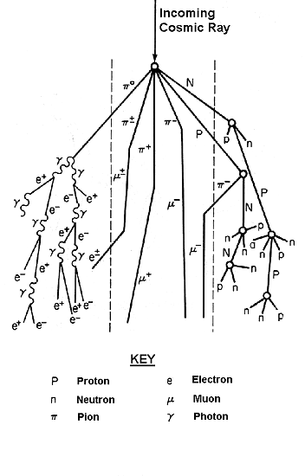
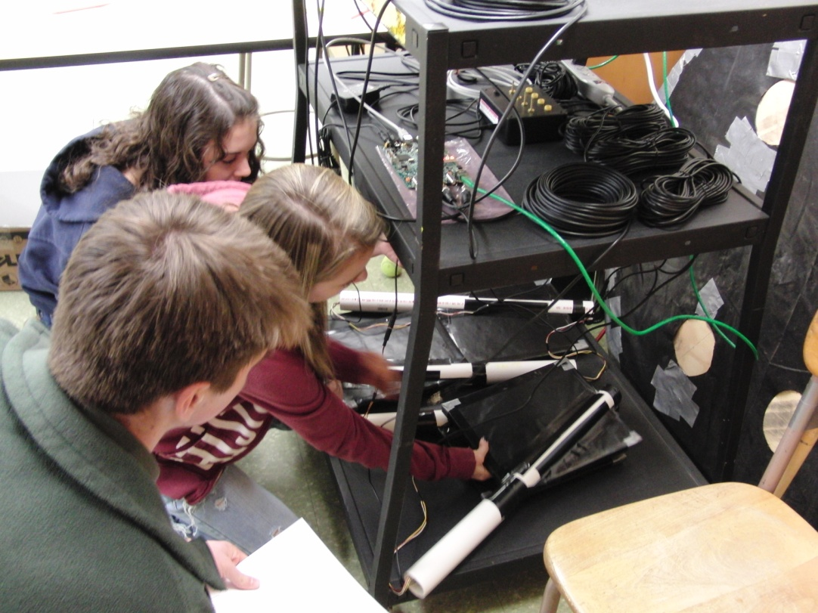
Teaching and Learning
with Cosmic Rays
Cosmic Ray e-Lab
Notes:
Private talk to ‘S’s: Most secret place in school? --> ‘T’ lounge. This is a ‘T’ workshop, but you get to listen in.
‘S’s most important here; you get to teach the ‘T’s.

Slide 7
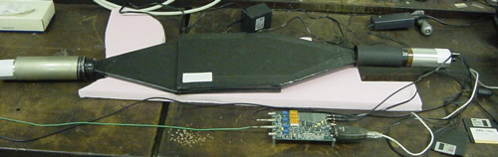
Teaching and Learning
with Cosmic Rays
QuarkNet Overview
QuarkNet Cosmic Ray Detector
Assemble CRMD hardware and take data.
Cosmic Ray e-Lab Exploration
Upload and analyze data.

Slide 8
Teaching and Learning
with Cosmic Rays
Workshop Objectives:
  Assemble CRMD: plateau, geometry, data-take.
  Record progress: LogBook.
  Design e-Lab investigation: data, tools, plots.
  Write report, present results.
  Share “Implementation Plan” and strategy.
Notes:
Pass on Plateauing if the workshop is constrained.
Leave the group with the e-Lab Fellows powerpoint and spreadsheet.
!! search data, analysis tools, save plots !!

Slide 9
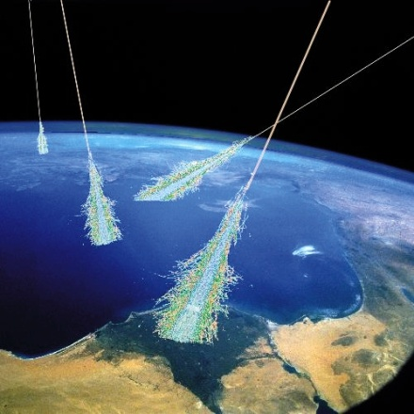
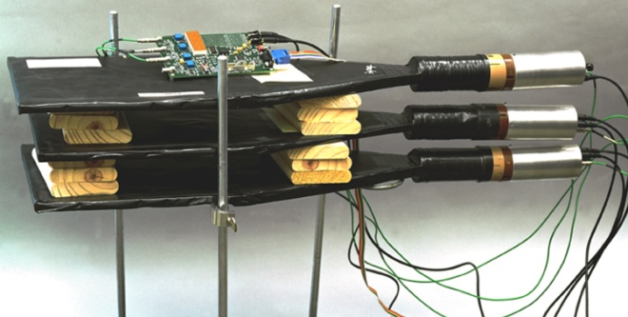
Teaching and Learning
with Cosmic Rays
Cosmic Rays
  Sources
  Composition, energy spectrum
  Detection
  Current experiments
The QuarkNet Classroom Detector
  Hardware overview
  Classroom use
  Experiments, measurements
Data Analysis
  Upload, analyze data & save data products.
  Share results.
  Enter logbook notes.
Notes:
CONNECTS: PARTICLES <--> HARDWARE <--> SOFTWARE

Slide 10
Teaching and Learning
with Cosmic Rays
Cosmic Ray e-Lab Stats: May 2010
774 teachers accounts
1,515 student research groups
519 DAQs worldwide
335 detectors in high schools
27,548 data files
498 posters

Slide 11
What is Quarknet?
Physicists, teachers & their students collaborate on research projects and investigations.

Slide 12
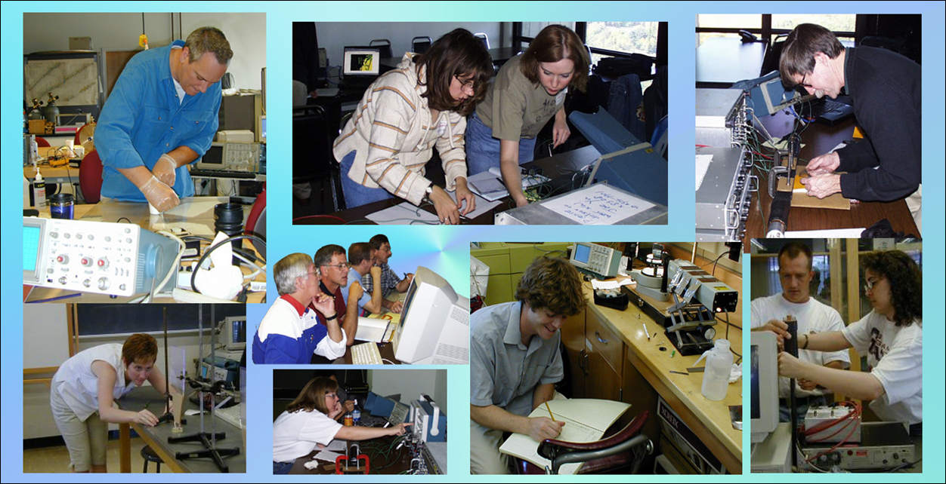

Slide 13

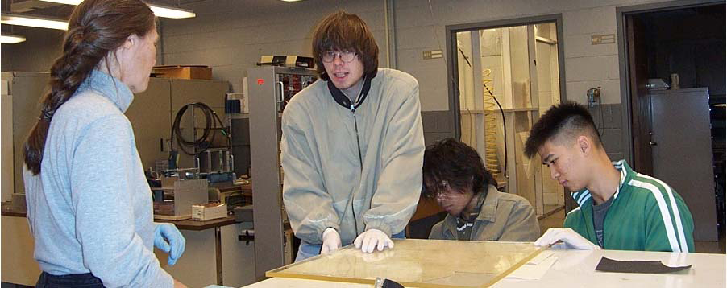
Physicists, teachers & their students collaborate on research projects and investigations.
Scientists as mentors
Teachers as researchers & facilitators
Students as researchers

Slide 14
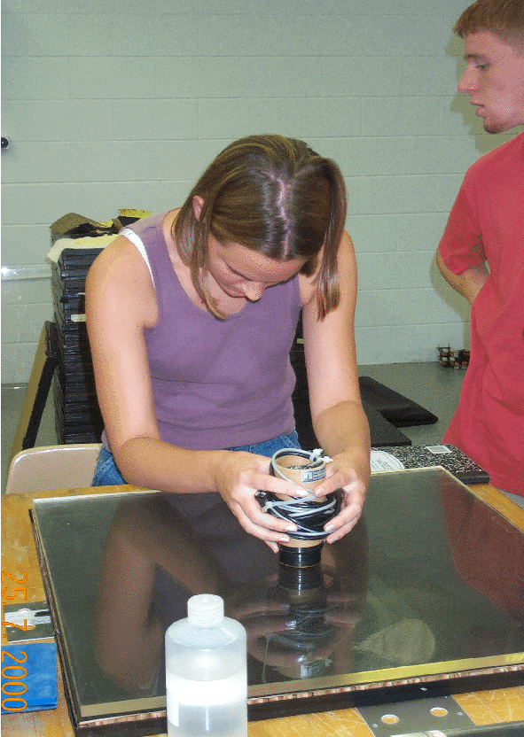
Vision
A lasting community of researchers that includes high school teachers and students as well as physicists
“Doing science.”
School science reflects the
practice of science. Science
Is what students DO, not
what is done to them.

Slide 15
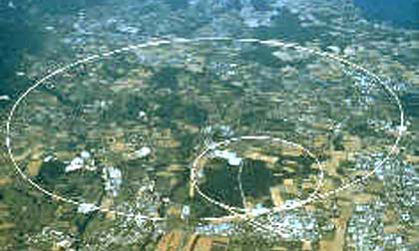
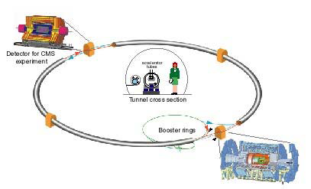
Why QuarkNet?
Our understanding of the universe is about to change as a new accelerator, the LHC, and its experiments, ATLAS, CMS, ALICE and LHCb turn on.
Join particle physicists to work on physics projects exploring the nature of matter, energy, space and time.

Slide 16
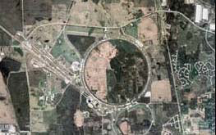
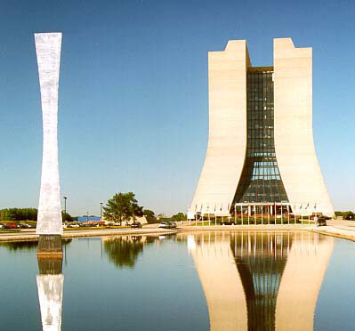
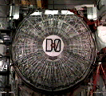



QuarkNet Origins
CDF & DØ
at
Fermilab

Slide 17
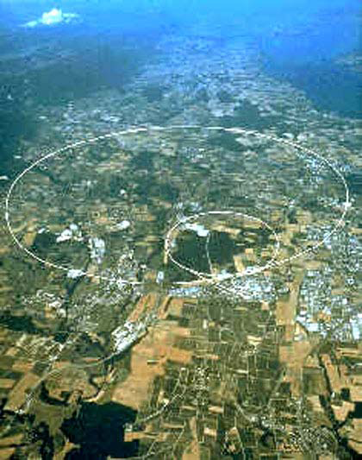
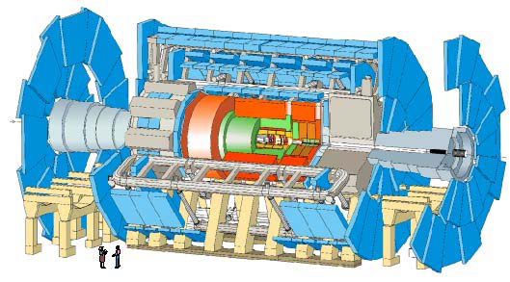
Quark Net Origins
ATLAS and CMS at CERN

Slide 18
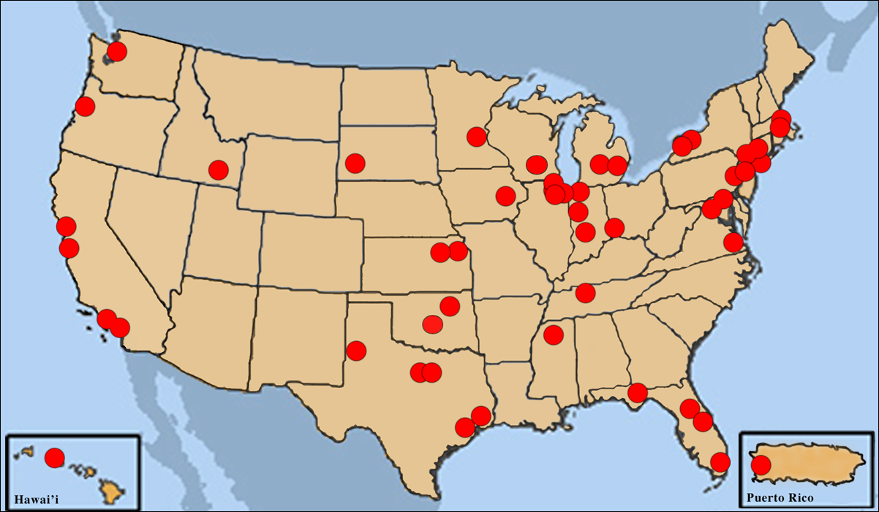
Current Active Centers

Slide 19
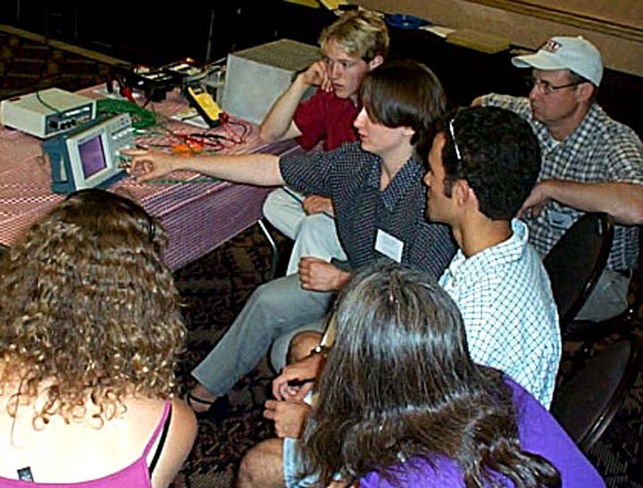
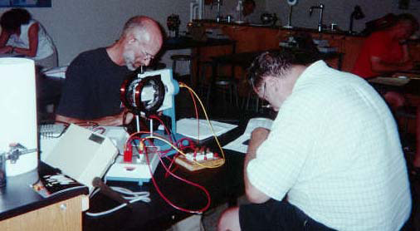
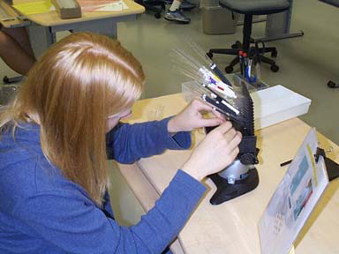
Current Status
53 Active centers
158 Mentors
615 Teachers
108 Summer students

Slide 20
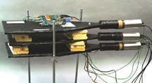
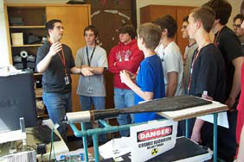
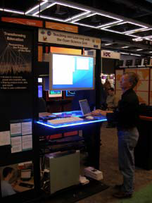
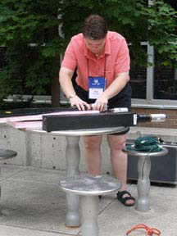
The QuarkNet Collaboration
Cosmic Ray Detector
Teachers’ idea
Several prototypes
Collecting data led to e-Lab

Slide 21

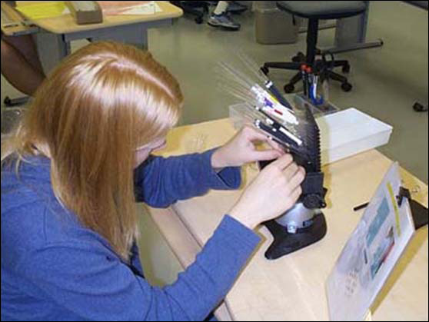
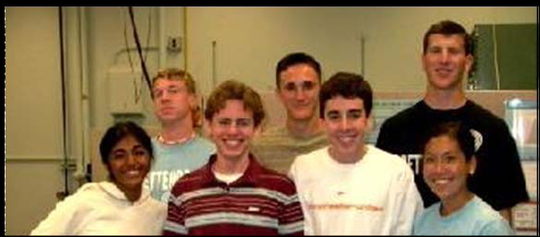
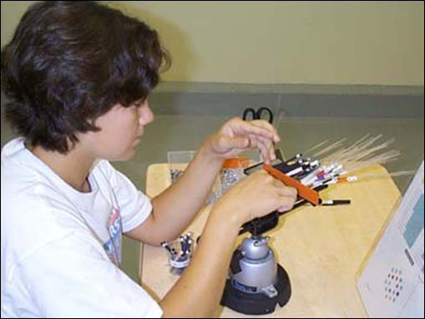



Student Summer Research
11 centers with 4 student slots each (avg)

